Slide 1



CCB RISK MODELLING
CASE STUDY PRESENTATION
JPMC CCB Risk Modelling Mentorship
Unnati Singh

Slide 2
OBJECTIVE
For a financial organization, accurately assessing the risk profile of loan applicants is crucial to avoid losses from unworthy customers and opportunity costs from declining worthy ones.
A dataset of around 42,000 loan accounts from 2007 to 2011, containing demographic, credit bureau attributes, and loan statuses, is available for analysis.
The goal is to establish screening criteria based on relevant qualitative and quantitative customer attributes to approve or decline future applications, ensuring fair lending practices.

Slide 3
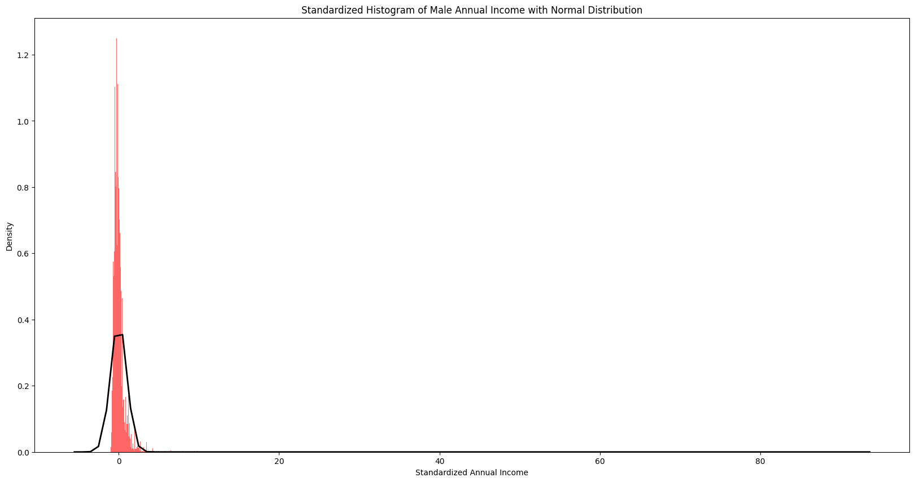
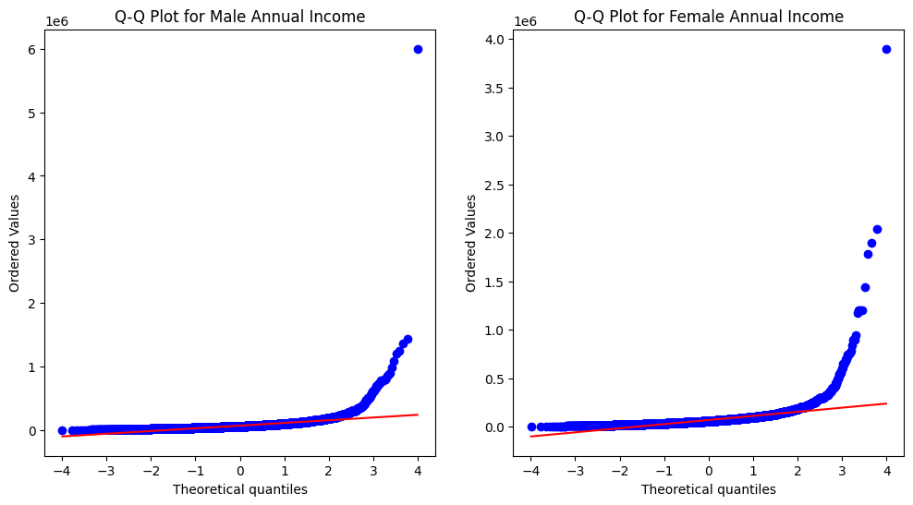
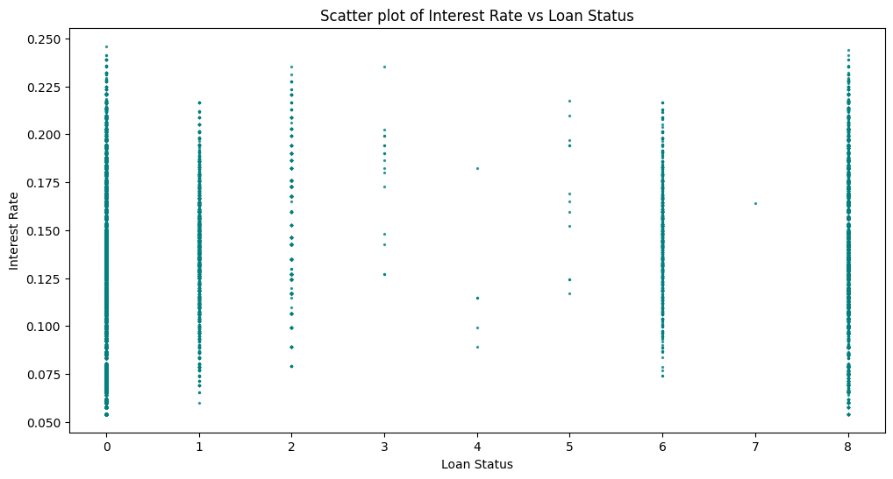
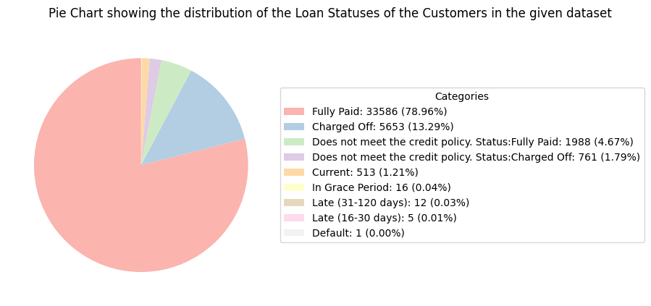
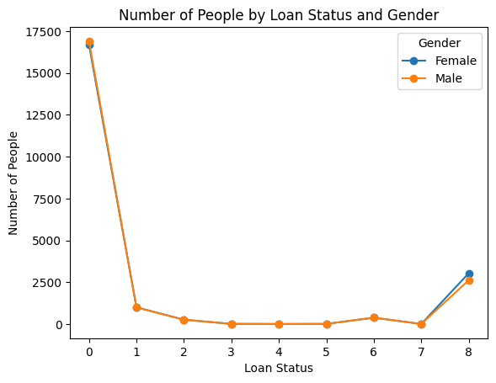
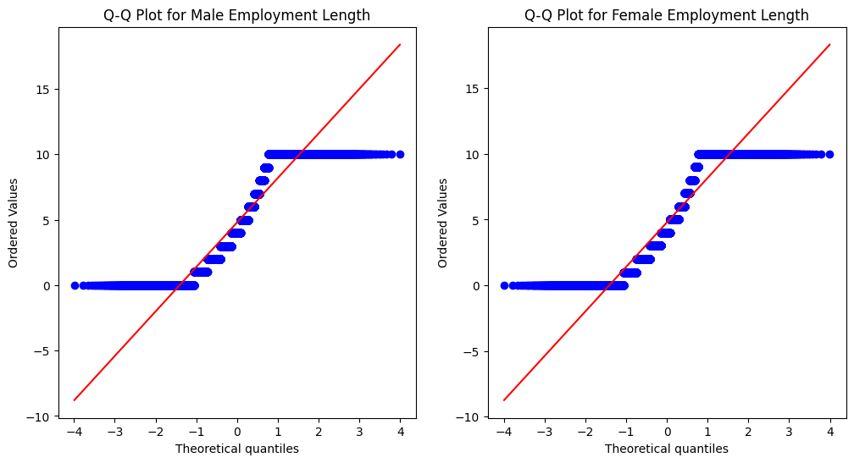
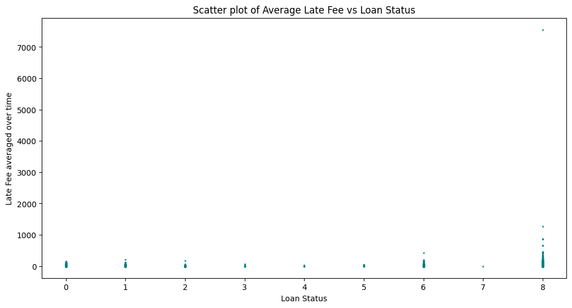
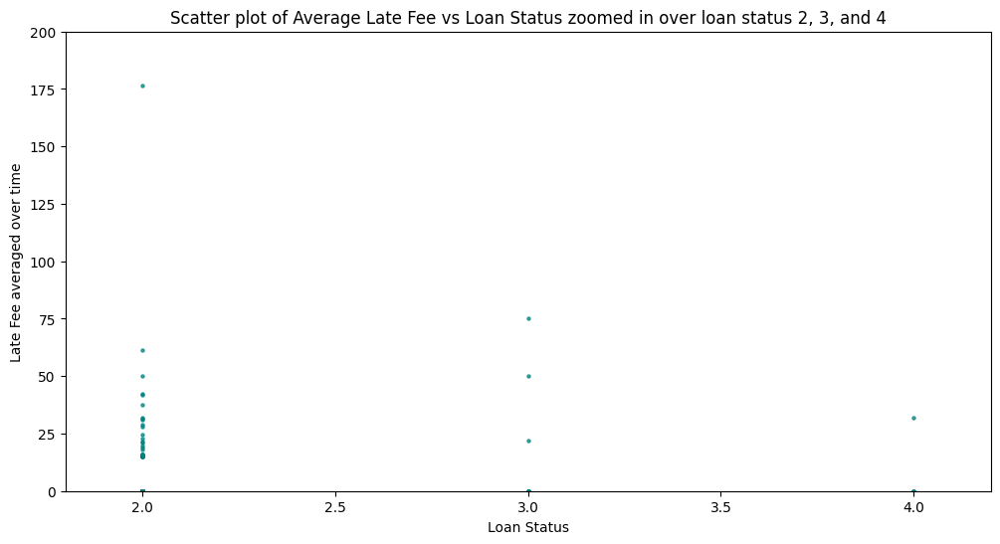
Pipeline
ANOVA Test Results on columns: | F-statistic | p-value
r1 | 59.16 | 1.34e-96
r2 | 645.04 | 0.0
r3 | 2426.94 | 0.0
r4 | 648.62 | 0.0
Interest Rate | 397.95 | 0.0
EDA
Training
Evaluation
Explanation
Mann-Whitney U Test p-value: 0.11701479118710642
Fail to reject the null hypothesis: There is no significant difference in annual income between genders.
EDA
Data Pre-processing
Missing Value and Outliers Handling
Removal of irrelevant columns
Removal of sensitive columns
Removal of post-loan approval columns
Forming the output variable
Statistical and Visual Analysis
Data Splitting
Data Augmentation
Graphs and Plots
Statistical tests
MODELS USED:
Logistic Regression
Decision Tree
Ensemble Model
Random Forest
XGBoost
Mann-Whitney U Test p-value: 0.9963843459616388
Fail to reject the null hypothesis: There is no significant difference in employment length between genders.

Slide 4
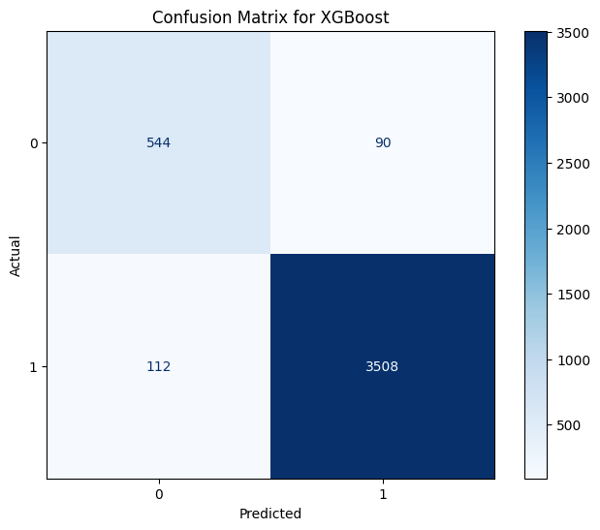
Evaluation
Since this is a classification problem, we use a Classification Matrix to evaluate our model.
During the first attempt of training, the post-loan approval variables were not removed from the input columns, giving a near perfect accuracy.
After removing these columns, the models were evaluated again.
Train Set Metrics | precision | recall | F1-score | support
0 | 0.98 | 0.96 | 0.97 | 32488
1 | 0.96 | 0.98 | 0.97 | 32488
Accuracy |  |  | 0.95 | 64976
Macro avg | 0.91 | 0.91 | 0.91 | 64976
Weighted avg | 0.95 | 0.95 | 0.95 | 64976
Test Set Metrics | precision | recall | F1-score | support
0 | 0.83 | 0.86 | 0.85 | 634
1 | 0.98 | 0.97 | 0.97 | 3620
Accuracy |  |  | 0.95 | 4254
Macro avg | 0.90 | 0.92 | 0.91 | 4254
Weighted avg | 0.95 | 0.95 | 0.95 | 4254

Slide 5
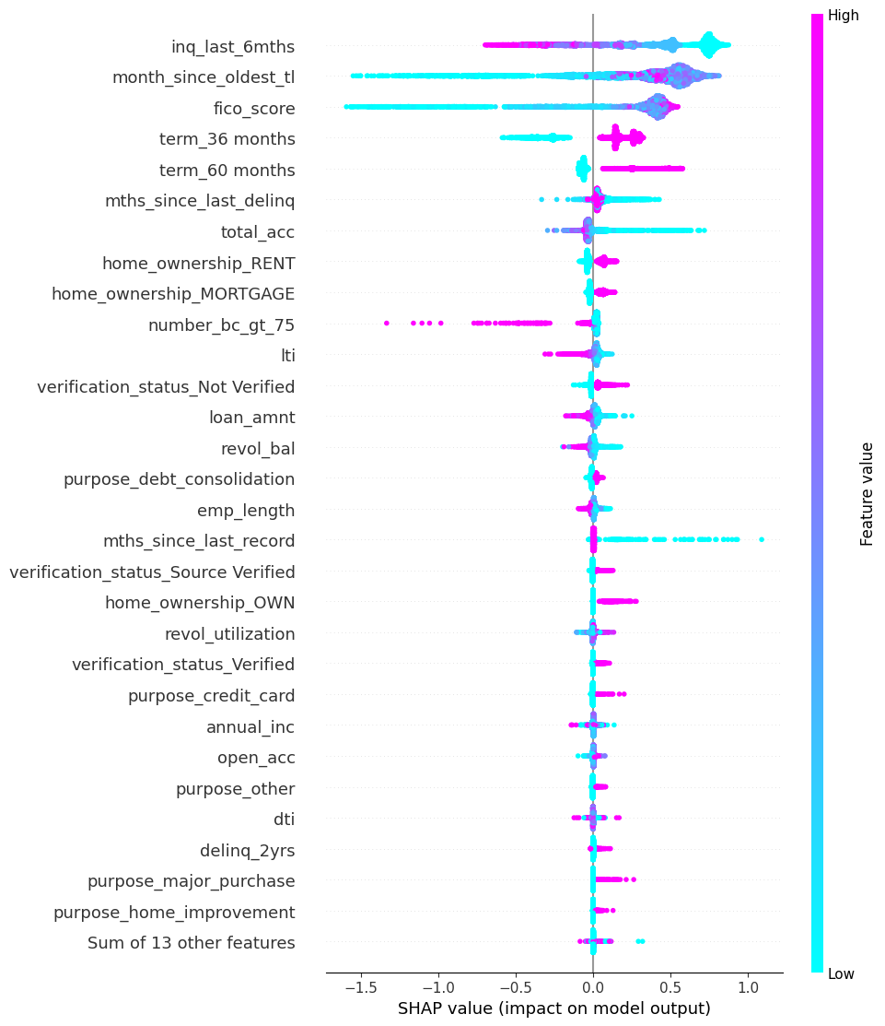
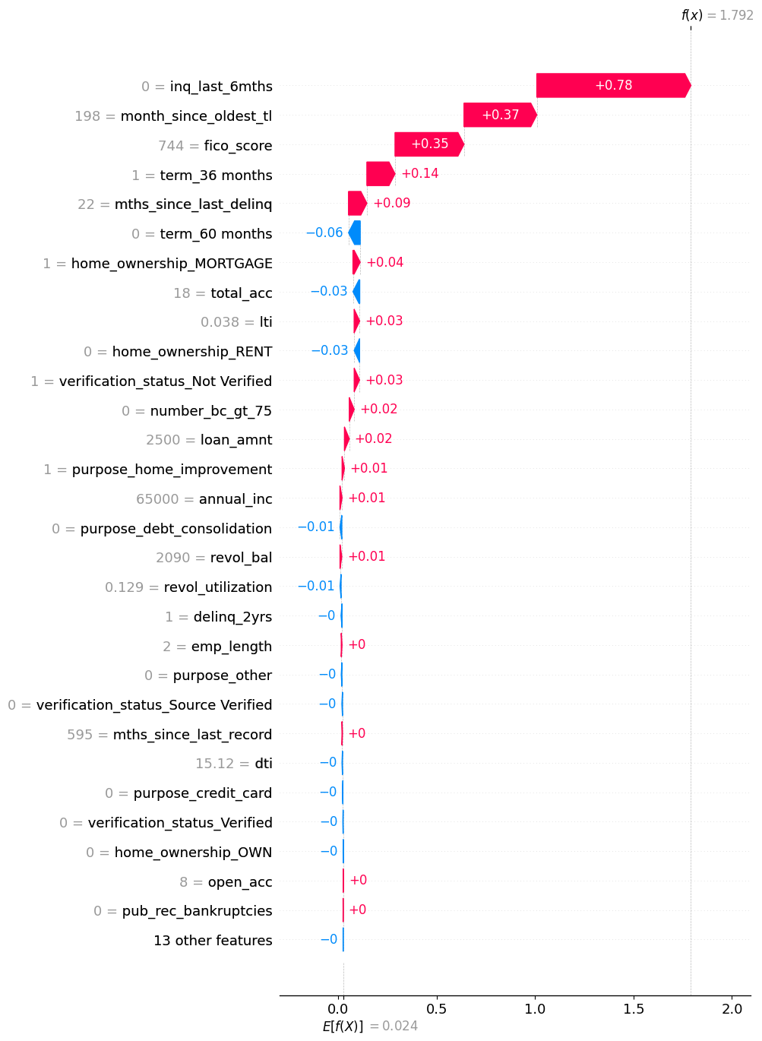
Explanation of Model Output
According to the Equal Credit Opportunity Act (ECOA), a customer has the right to know why the creditor rejected their application.
To help understand the decisions of our model, we can use SHAP.
SHAP explanation for the entire test set
SHAP explanation for one case

Slide 6
Post prediction Steps
As new data keeps on being added to the model it is important that we keep making sanity checks to make sure that we are getting reasonable predictions.
This can be ensured by using statistical tests like t-test and chi-square to make sure that there is no inherent bias in the model regarding any sensitive variable. These checks should happen at regular intervals to maintain the integrity of our model.
Chi Square Test Of Independence | Chi Square Statistic | p – value (α = 0.05) | Critical Value | Result
Gender | 0.0 | 1.0 | 3.84 | Fail to reject the null hypothesis: There is no significant association between model output and gender.
Race | 0.29 | 0.96 | 7.81 | Fail to reject the null hypothesis: There is no significant association between model output and race.
Address State | 39.07 | 0.72 | 61.66 | Fail to reject the null hypothesis: There is no significant association between model output and address state.

Slide 7
Summary
Exploratory Data Analysis:
Observed feature correlations using plots and statistical tests
Dropped irrelevant columns and handled missing data and outliers.
Modelling and Evaluation:
Used SMOTE to oversample data and get equal representation of class labels.
Observed performance of different ML algorithms on the dataset.
Explainability:
Used SHAP to get an understanding of how feature values affect the final decision of the model.
SHAP score being fed into the sigmoid function gives the probability of the applicant to be a good candidate for the loan.
Post Prediction Steps:
Engineered new features to ensure smooth modelling.
Obtained F1-Score of 0.95 on test set using XGBoost.
Continuous monitoring using statistical tests to avoid inherent bias in the model.
For our model, chi-square test of independence was used to give a baseline performance.

